Slide 1
BMI CALCULATOR WEBSITE
Amani Katana HDB212-C005-0020/2018 BBIT
Edward Lengah HDE223-C005-0372/2017 BSCM
Cecilia Kyuvi SCT221-C005-0135/2016 BSCIT
E-Commerce CAT
BIT 2315
Presented on 16th October 2019.

Slide 2
What is BMI?
Body Mass Index (BMI) is a measure of body fat based on height and weight.
How do you Calculate BMI?
Metric BMI Formula
BMI = weight (kg) / [height (m)]²
Imperial BMI Formula
BMI = 703 × weight (lbs) / [height (in)]²

Slide 3
ITS UNIQUENESS
This webpage is created to promote healthy living, fitness and to combat obesity. A common statement of every conscious mind of today's world is "Am I Healthy?" Burning calories has become a trend, and as a result, so have gymnasiums, sporting activities and even casual exercise routines. In a modern day city it is assured that you can find at least one gym near you, not just for convenience and allowing you to better your health, but to also remind you that you can always better your well being and keep in tip-top shape.

Slide 4
How the site can help earn revenue
Selling the system to gymnasium and have it embedded to run side by side with the websites they have already created.
Customizing the website to suit the needs of a specific gymnasium and sell them the whole website and system.
Charging users for upgrade features such as graphical representations of their data, sending notifications to users reminding them to work out and providing daily health advice.
Setting Google Ads to the website and increasing user traffic with Search Engine Optimization and advertising the website.
Monetizing user data to companies like Google, Oracle, Microsoft and Apple.
Embedding the website with personal fitness applications such as Google Fit.

Slide 5
Tools used to create the website
1 Cascading Style Sheet (CSS) – Contains the properties and behaviours of the various components inside the website such as images, text and hyperlinks.
1 Extensible Markup Language (XML) Document File (DOCX) – This is the Microsoft Word document that explains the key features of the website and how to run it properly.
13 Graphics Interchange Format Images (GIFs) – These are dynamic images that set an aesthetic feel to the website.
12 Hypertext Preprocessor Files (PHP) – These are server side scripts that are used to develop dynamic websites or web applications. They contain the codes of the components in the website.
16 Joint Photographic Expert Group Images (JPGs) – These are non-dynamic images that are eye catching, clearly puts across a point and prepares the person to expect a certain topic to be covered.
1 Portable Network Graphics Image (PNG) – These are small images with a transparent background, in this case, acts as the logo.
1 Structured Query Language File (SQL) – This is a database that has been exported for the purpose of easy transfer. Once imported into the system, it dynamically adapts as the website grows.

Slide 6
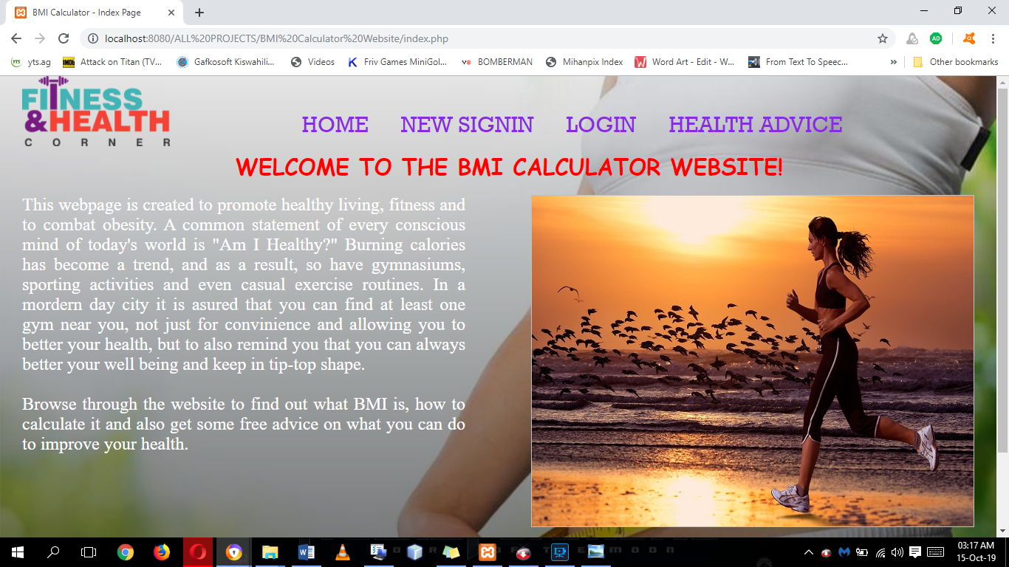
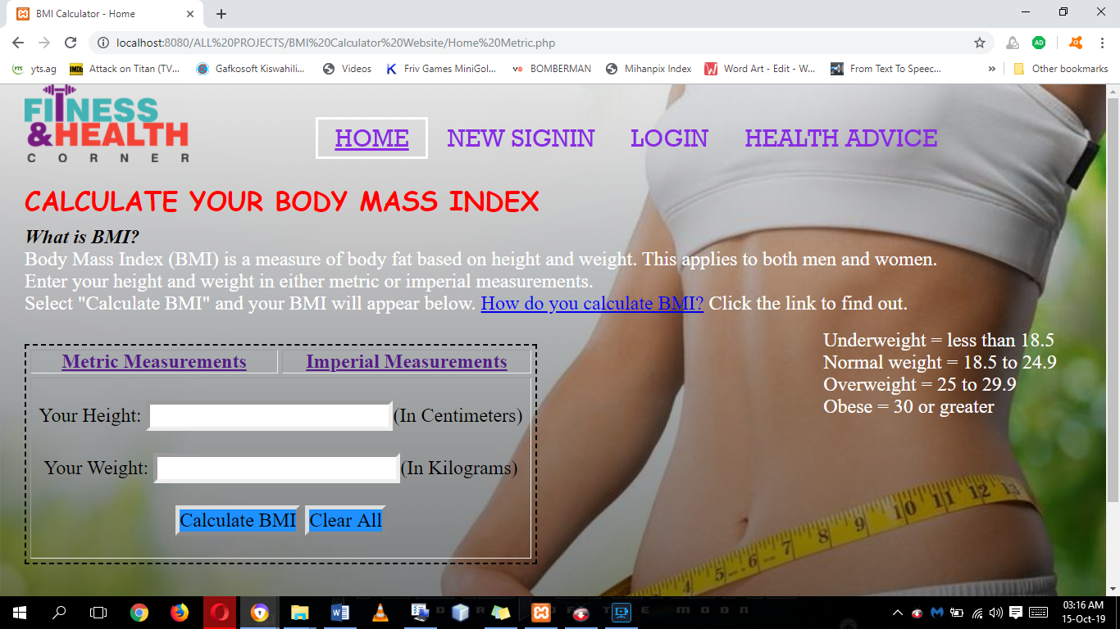
Website pages
Index Page
Explains why the website was created and how viable it is in modern society. This page contains a slide show of images.
Home Page Metric Measurements
Explains why the website was created and how viable it is in modern society. This page contains a slide show of images.

Slide 7
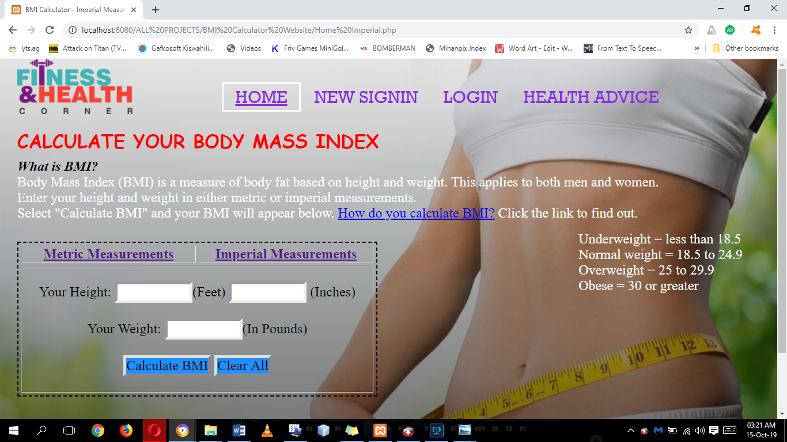
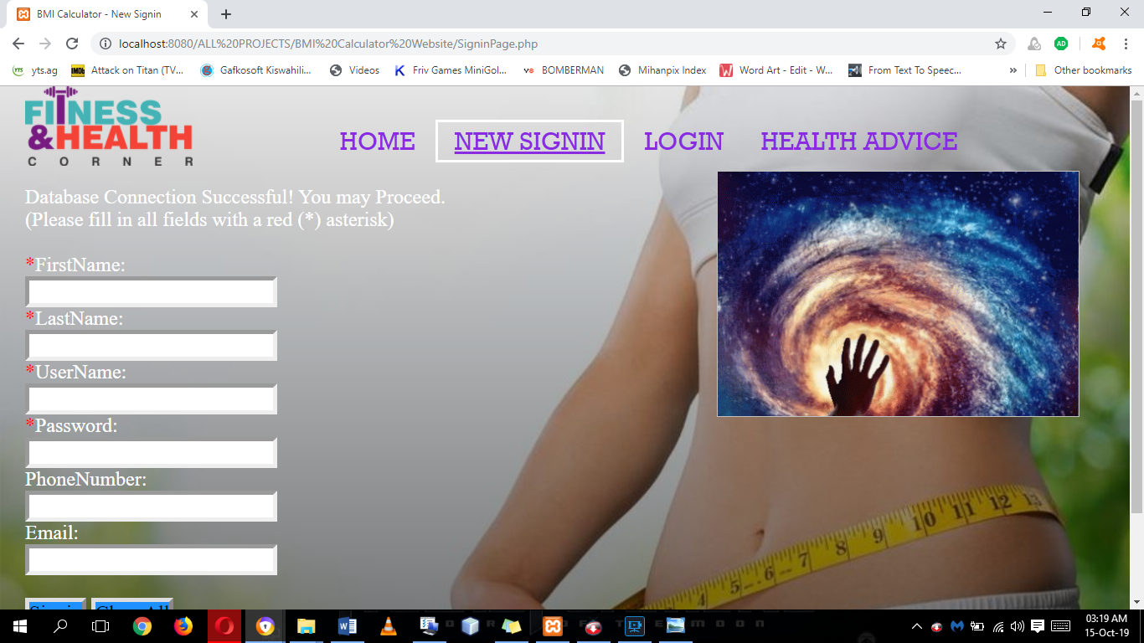
Website pages
Home Page Imperial
Explains what BMI is and allows any user (whether logged in or not) to interact with the website and calculate their BMI in imperial system.
Sign In Page
Allows the creation of new users to the website. This page contains a slide show of gifs.

Slide 8
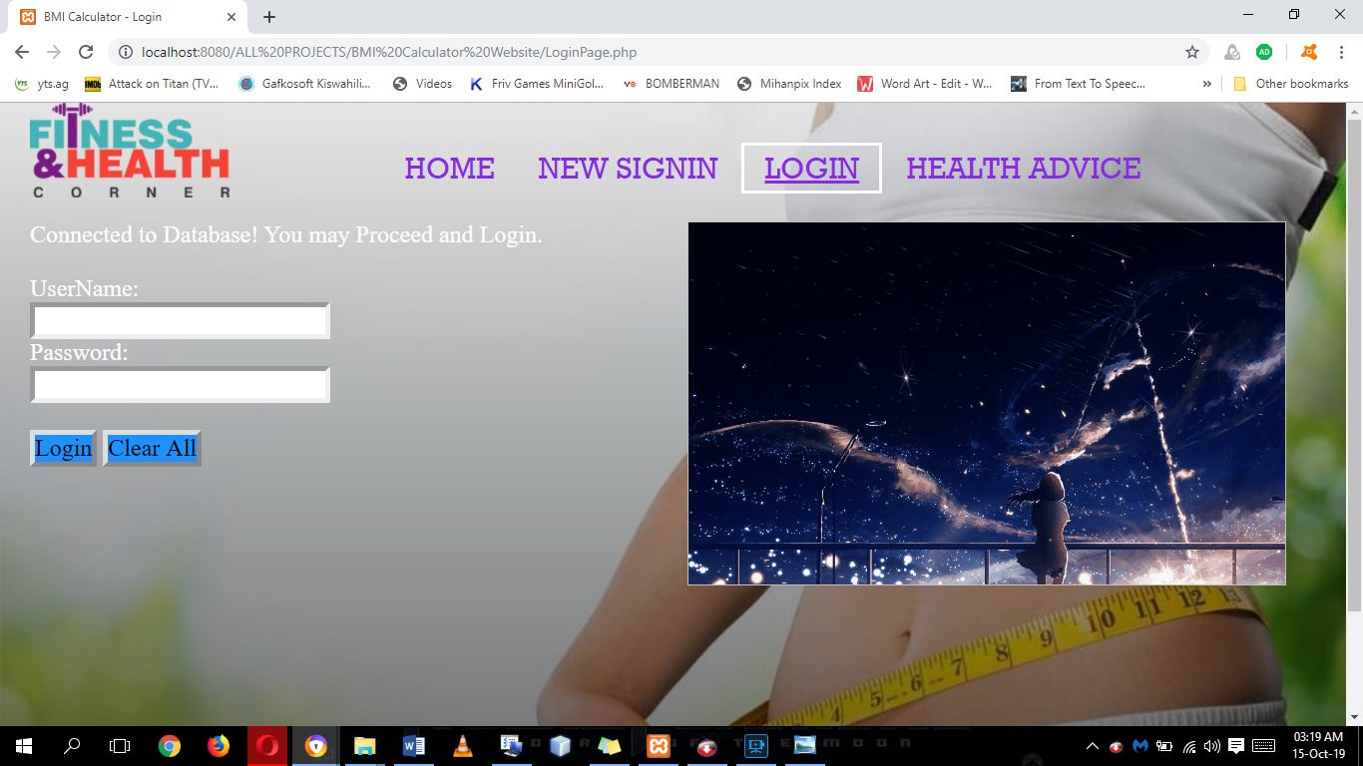
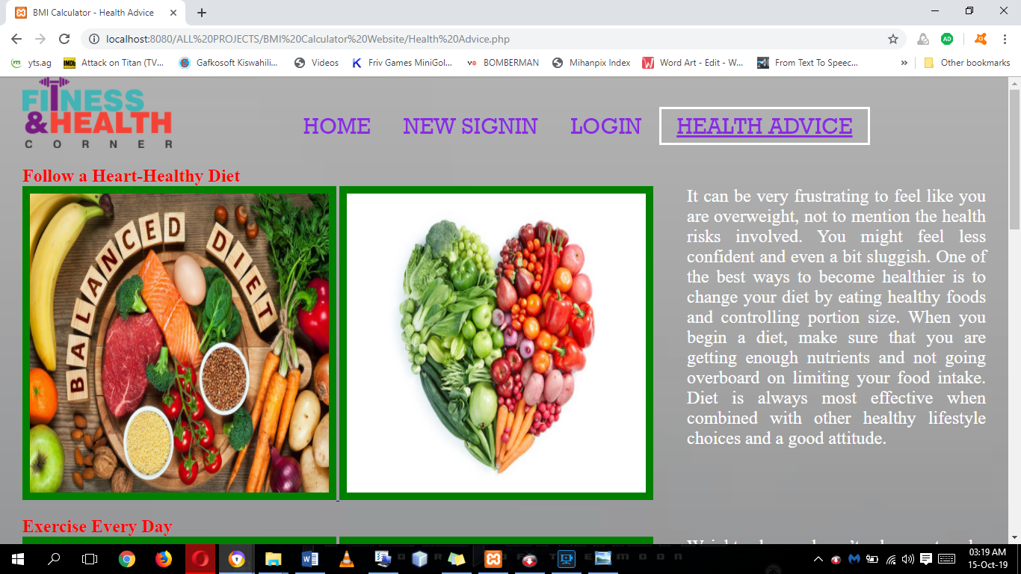
Website pages
Login Page
Allows persons with usernames and passwords to login to the system and save their data onto our database. This page contains a slide show of gifs.
Health Advice
Allows any user to access free advice on how to improve one’s well-being and encourage them to live healthy lives.

Slide 9
Database Design
New Sign In and Login
Field Name | Datatype | Description | Constraints
SigninID | int(5) | Stores the User’s ID | Primary Key, Auto Increment
FirstName | varchar(15) | Stores the user's First Names
LastName | varchar(15) | Stores the user's Last Names
UserName | varchar(30) | Stores the User Name of the user that is used during login. | Unique Key
Password | varchar(30) | Stores the Passwords for the users
PhoneNumber | varchar(10) | Stores the user’s Phone Number | Unsigned Zerofill
Email | varchar(50) | Stores user’s Email Address
User’s Data Table
Field Name | Datatype | Description | Constraints
BMIID | int(4) | Stores the BMI’s ID | Primary Key, Auto Increment
Date | Date | Gets the current system date
Height | int(5) | Stores the User’s height
Weight | int(5) | Stores the User’s Weight
BMI | varchar(6) | Stores the Passwords for the users

Slide 10
THANK YOU

